Slide 1
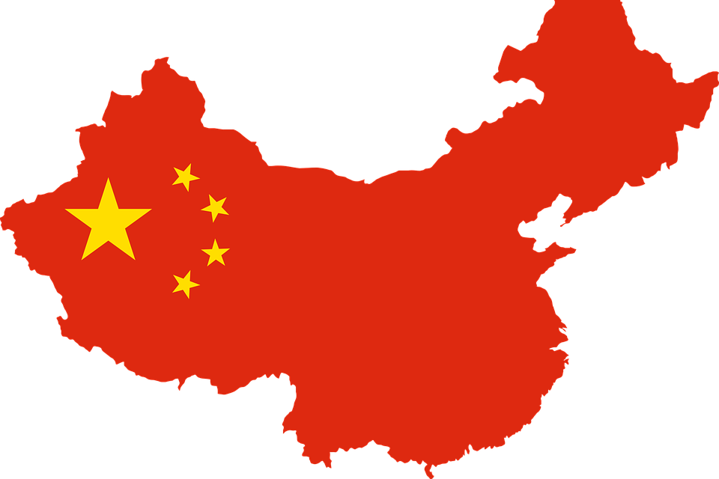
People’s Republic of China
Kajol Choudhary 16UCS224
Komal Kungwani 16UCS093
Mahima Kejriwal 16UCS225
Parul Shandilya 16UCS126
Priyansi Singh 16UCS143
Vrinda Goel 16UCS216
19 September 2019

Slide 2
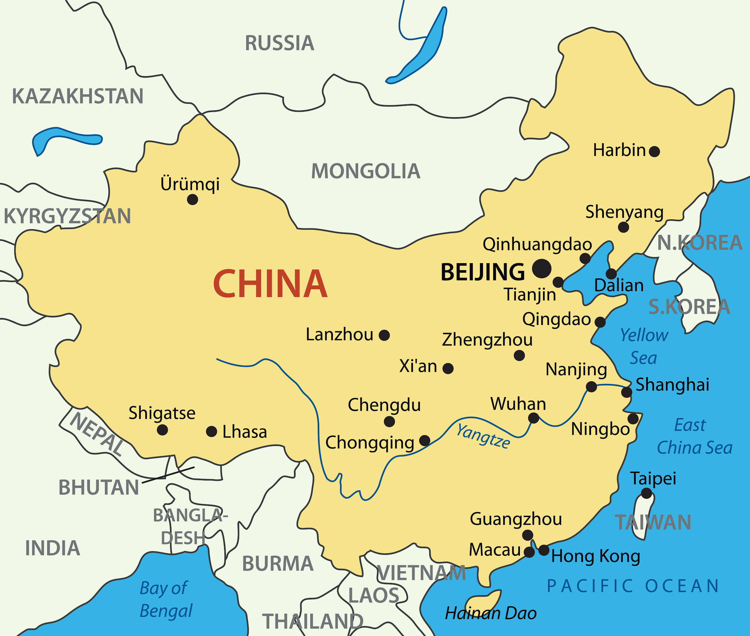
Map of China

Slide 3
KEY TAKEAWAYS
What is China?
History of China
Economic history of China and Communism
China on International grounds
Future Of China

Slide 4

What is China ?
Fourth largest country by area (9.5 million square km).
Largest country by population (over 1.4 billion).
Eleventh longest shoreline in the world (over 9000 miles).
World’s second largest economy ($13.45 trillion).
Largest standing army (over 2 million).

Slide 5
The Economy of China
World’s largest producer and consumer of agricultural products and producer of steel.
Ranks 3rd in industrial output.
Workforce of 300 million chinese farm workers.
Industry and construction accounts for about 46.8% of China’s GDP.
In 2012 China became world’s leading trading nation surpassing USA with export and import worth of $3.87 trillion.

Slide 6
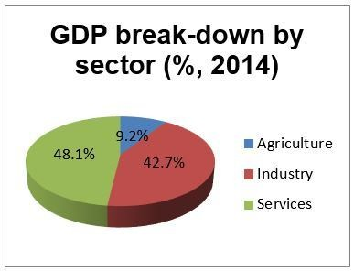

Slide 7
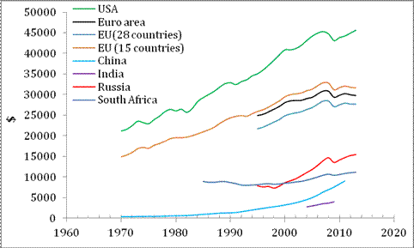
Real GDP per head of several countries

Slide 8
The History of China
For the last two thousand years, China was one of the world's largest and most advanced economies.
China was the scientific leader of the world.
China had huge trades in silk and tea.
Invented gunpowder and paper.

Slide 9
The fall of economy and rise of Communism
Until 1500 AD China commanded 33% share in the world economy.
However, China fell into an internal war with Opium which slogged the entire economy until the 1960’s.
In 1919, a civil war grew out between the newly formed Communist Party and the Qing Empire, resulting in the disintegration of the latter.
The communist party took over China in 1949, thus starting the era of Communism.

Slide 10
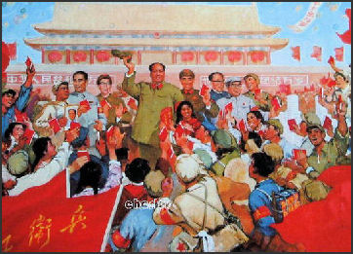
The Mao Era
The period from 1949-1976 was famously named the Mao Era.
This era was a period of cultural revolution.
It also saw the abolishment of Opium.
Banking system was introduced.

Slide 11

What is Communism?
A theory or system of social organization in which all property is owned by the community and each person contributes and receives according to their ability and needs.

Slide 12
PROS
CONS
Everyone gets the same chance.
Almost everyone is employed.
Almost everyone is educated.
Individual rights are restricted.
There is no unauthorized opposition.
People are kept in ignorance.
Earning is limited.

Slide 13
The Deng Era
Several economic reforms were introduced in 1979.
The program of economic reforms termed "Socialism with Chinese characteristics" and "socialist market economy" in the People's Republic of China.
Often referred to as the opening of Chinese markets.
Resulted in rapid development of China with double digit growth for 3 decades.
Ultimately, converted into manufacturing hub and the concept of Special Economic Zones was introduced.

Slide 14
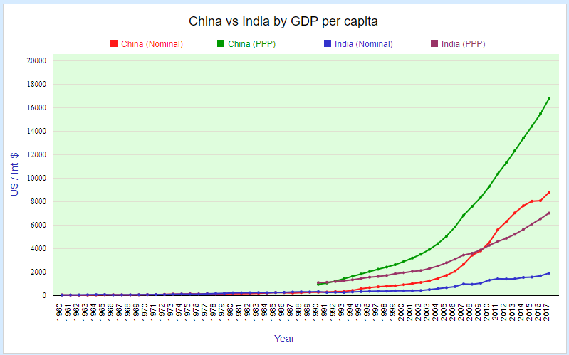
GDP of China

Slide 15
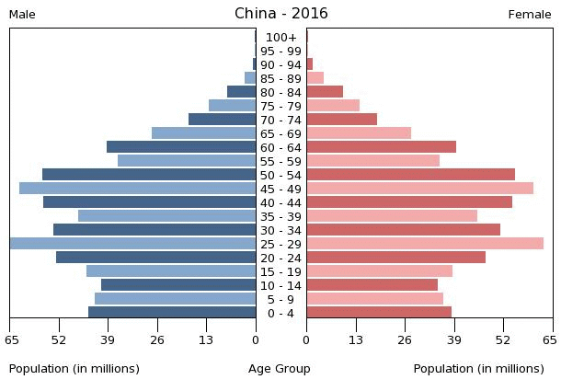
One Child Policy
Established across the country in 1980.
Aim was to reduce the growth rate of China’s enormous population.
The fertility rate dropped from 2.81 in 1979 to 1.51 in 2000.
Began losing its greatest asset: cheap labor force

Slide 17
Nine-year compulsory Education
took effect on July 1, 1986
Aim:
to eliminate illiteracy
to upgrade quality of life
to eliminate poverty and achieve sustainable social progress.
resulted in developing strong human resources.

Slide 18
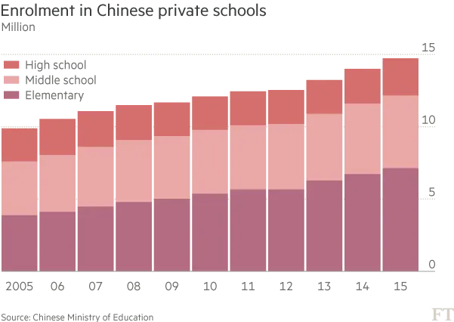

Slide 19
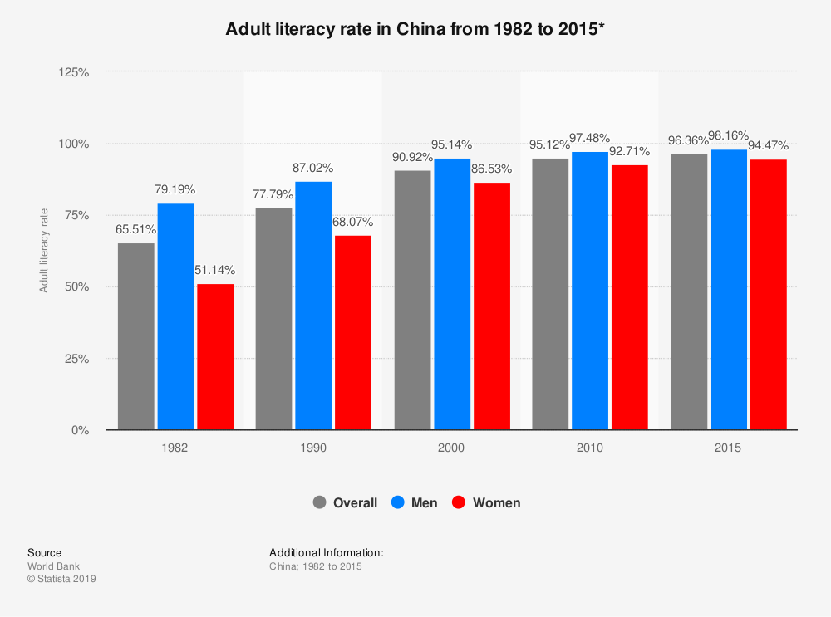

Slide 20
China Property Law
Law passed in 2007.
Ownership isn’t granted.
Increased family incomes
A large number of workforce is exploited under this law.
Separation from family members
Workers are manipulated by state government as per their incentives in manufacturing plants.

Slide 21
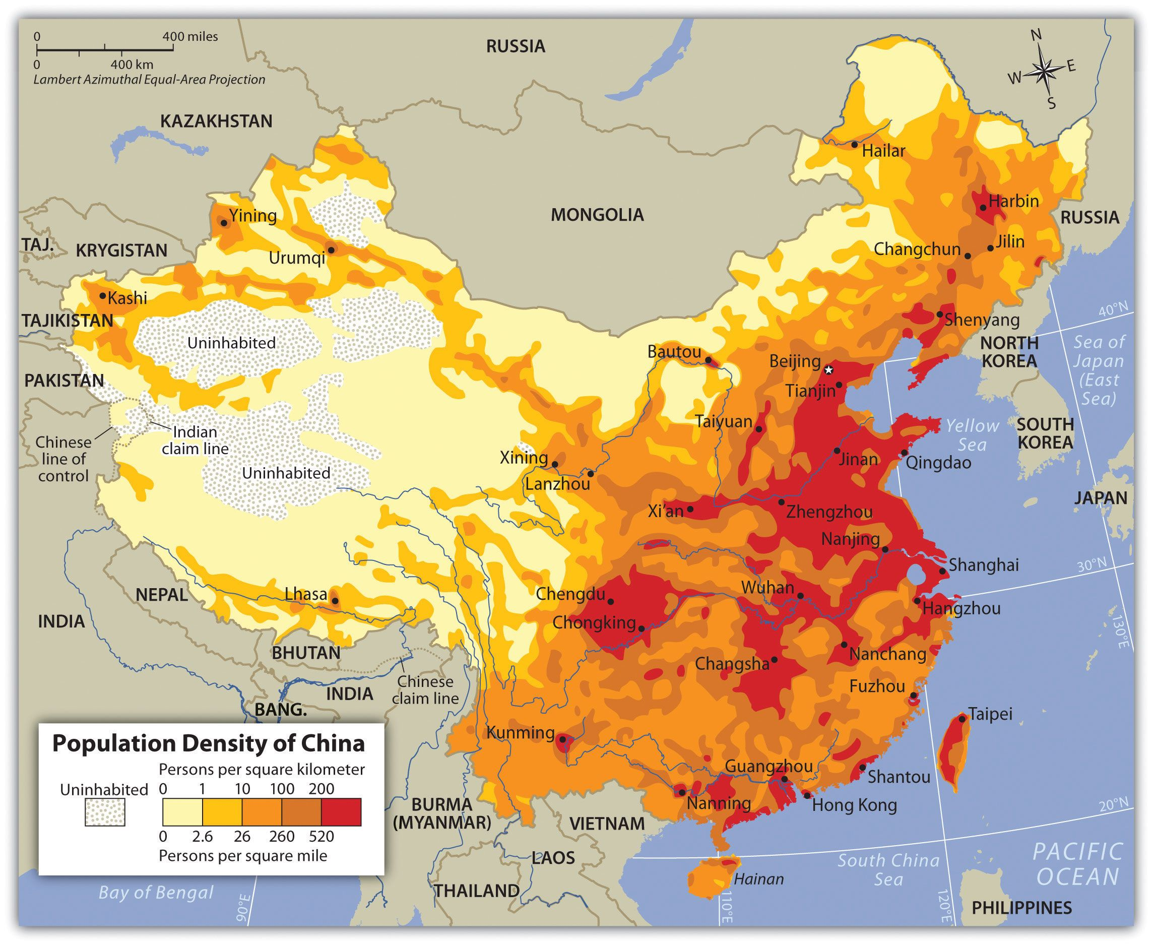

Slide 22
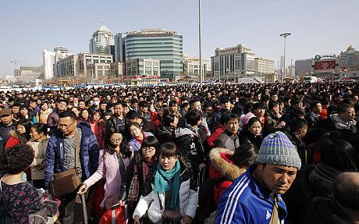
Massive Migration
288 million rural migrant workers in China .
Chinese New Year “Chunyum” period of 40 days in month of january- february.
Migrants travel to their home once a year .
2.99 billion trips - 2.46 billion : automobile , 413 million : rail , 73 million : air
Passengers wait in a line to enter a platform at a railway station in Beijing (Reuters)
Notes:
288 million rural migrant workers in China in 2018, making up more than one third of the entire working population
Chunyun," it's the 40-day period when Chinese people head home to celebrate the Lunar New Year Spring Festival with their families.
Of those, 2.46 billion trips will be made by automobile, 413 million by rail -- a rise of 8.3% -- and 73 million by air.

Slide 23
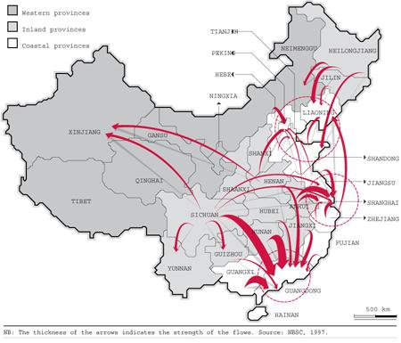
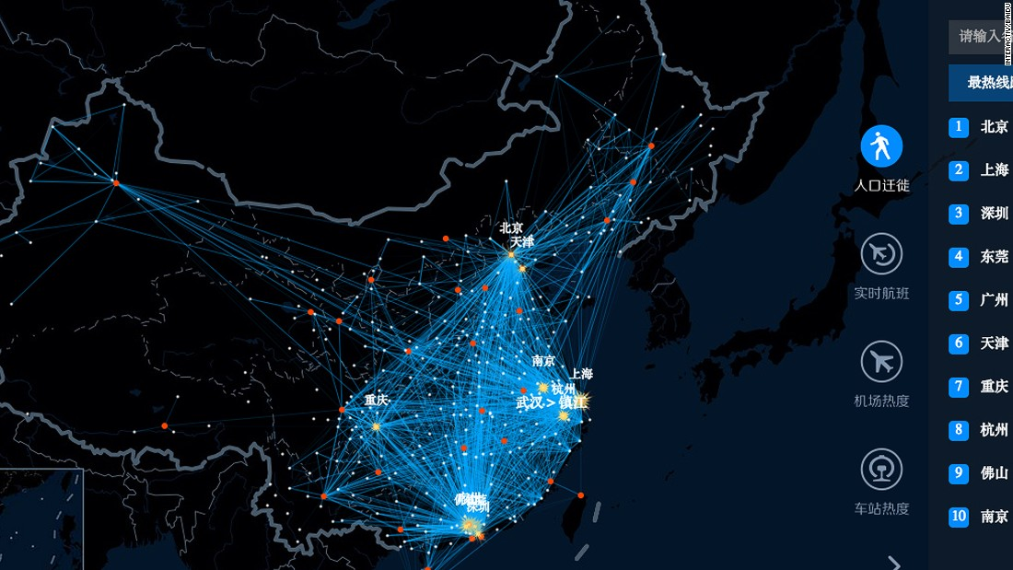
R Reason :
About 89% of its citizens lived in rural areas - 1949
Communist China - opened door to factories in coastal towns .
Underpriced agricultural products and overprized industrial products.
Introduced Hukou system - 1958
Notes:
In 1978 everyone was poor, and rural incomes were less than 40% of urban ones. Suddenly Communist China threw open its doors and factories appeared in coastal towns, where farmers could make more money in a month than in a year growing rice.
Farmers - opportunity to make more money in a month than in a year by growing rice.

Slide 24
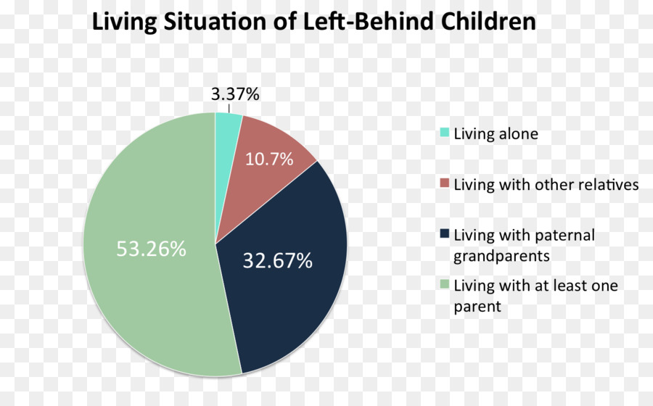
Hukou system
System that denied the migrants the same right enjoyed by urbanites.
By late 1970's, 260 million rural people illegally moved .
Effect on Children
Migrant children education - limited access to social infrastructure .
Notes:
They will not be able to gain access to education, employment, food services, healthcare and other public services unless they obtain a government-issued urban-to-rural Hukou. To analogize, a rural farmer who decides to travel into the city without the necessary Hukou is like an illegal alien in America.
Following Mao's death in 1976 came economic reforms that caused a surge in demand in the labor market.^{[36]} Rural residents rushed to fill this void, but without the support of hukou status-based government social programs, many of them were forced to leave their families behind.

Slide 25
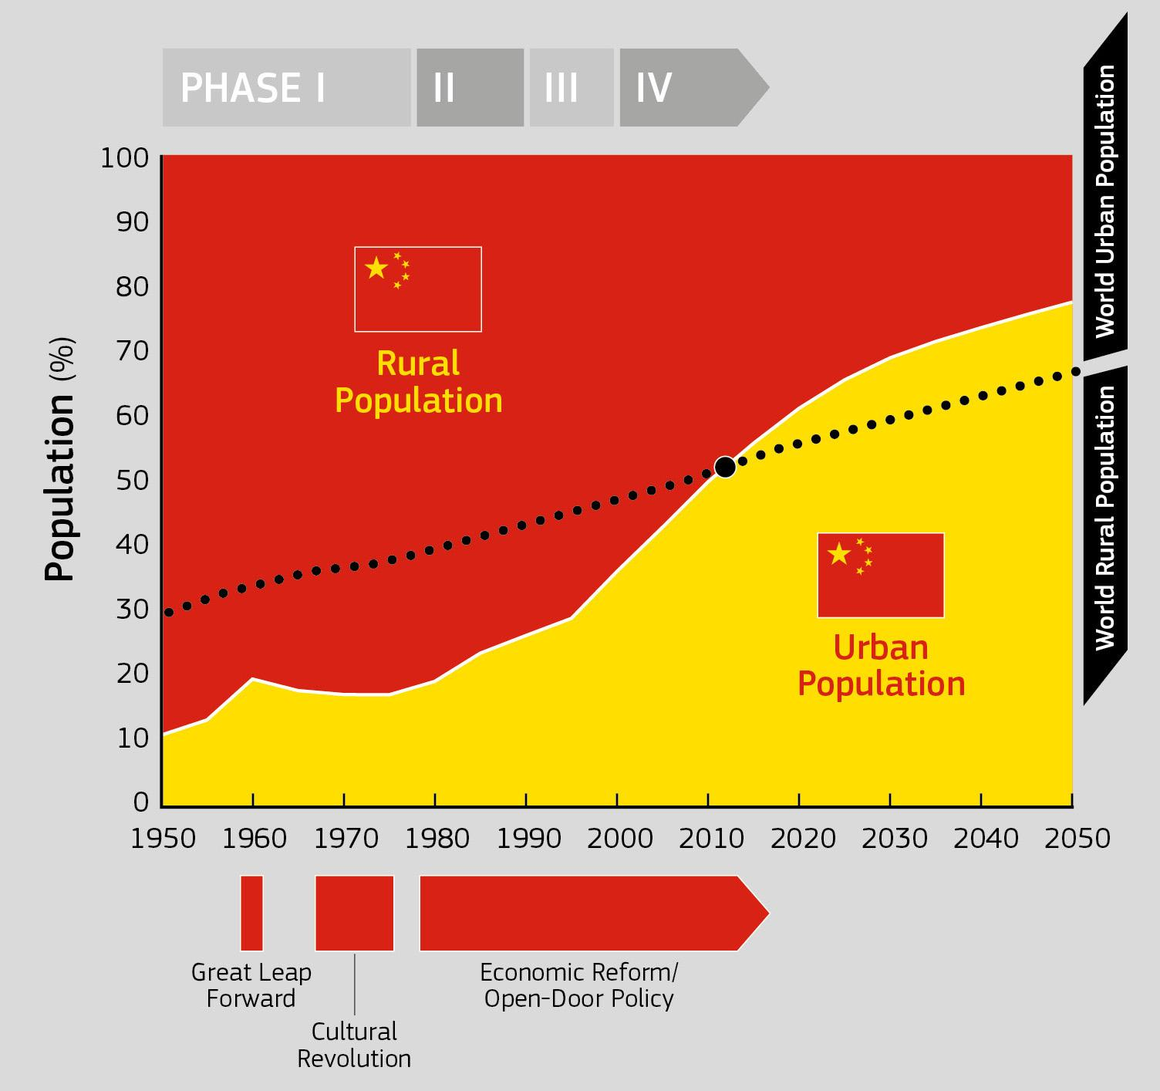
Population Distribution
1990- 1995 : 10 millions
1995 -2000 : 32 million
2000- 2005 : 38 million
By 2011 : 160 million rural Chinese away
from home .
Notes:
Migrants moved from the poorest inland provinces such as Guizhou, Sichuan and Anhui. In 1980 farmers here lived on less than $2 a day. According to Kam Wing Chan at the University of Washington, more than 10 million workers migrated out of their home province between 1990 and 1995. Another 32 million migrated from 1995 to 2000 and yet another 38 million over the next five years.
By 2011 nearly 160 million rural Chinese were working far from home. Between 2001 and 2010 migration contributed nearly 20 percent of China's economic growth but it has all come at a personal cost - many migrants spend years away from their family.

Slide 26
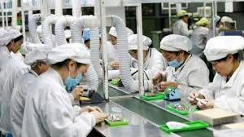
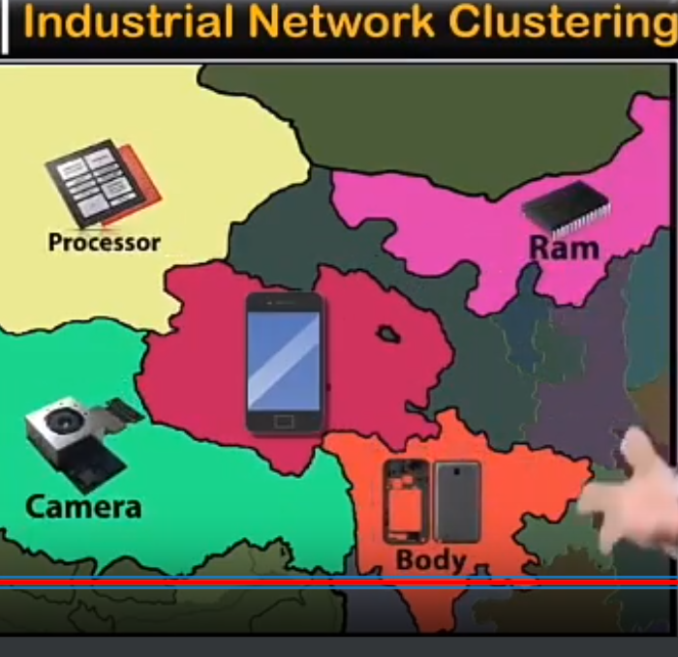
What China Does Compared
to India ???
Massive production and Dumping .
Competitive pricing with reverse manufacturing.
Cost effective labour- skill development.
Experience and expertise.- Global Manufacturing hub
Stability Assurance due to stable government - less time energy money
Industrial Network clustering
Notes:
1 1990 before india anti large scale industry .China sees what is the lowest price
2 reverse manufacturing America does all innovation R and d it openes their product apply to them it save cost of R and D india no global exposure we focus of discount
3 China labour is not cheap but output productivite they are skilled in dia we make mobile in 10 hours but they make in 1 hour skill development is needed.
4 ye me banadunga practice has make them expertise ,in india we donot have automated equipmemt and experience we have just entered the manufacturing set up.
Pic 1 tech industry
Pic 2

Slide 27

TR
High levels of FDI and R&D play
a role as drivers of regional
growth
The development of emerging
technologies in China – the case
of nanotechnology

Slide 28
China on International Grounds
China’s investment in Latin America
China’s investment in Africa
Neo-colonialism : the use of economic, political, cultural, or other pressures to control or influence other countries.

Slide 29
China Global Investment Tracker (CGIT), which monitors China’s construction activities and global investments valued at least $100 million.
foreign direct investment (FDI) -Developed Economies
Construction contracts-Developing parts of the world

Slide 30
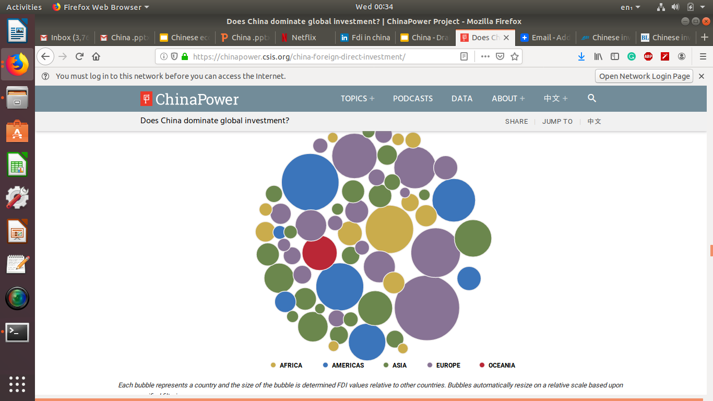
China Bilateral Investment Outflows
Notes:
China Bilateral Investment Outflows

Slide 31

Investment in Latin America
Investment less than $5 billion prior to 2010, when it jumped to $25.3 billion.
China was the biggest investor in LAC with deals totaling $18 billion (42 percent of the total).
Abundant natural resources make LAC a highly desirable investment destination for China
China Development Bank and the Export-Import Bank of China – have issued 85 loans amounting to $150.4 billion from 2005 to 2017 for energy, transportation, and infrastructure projects.

Slide 32
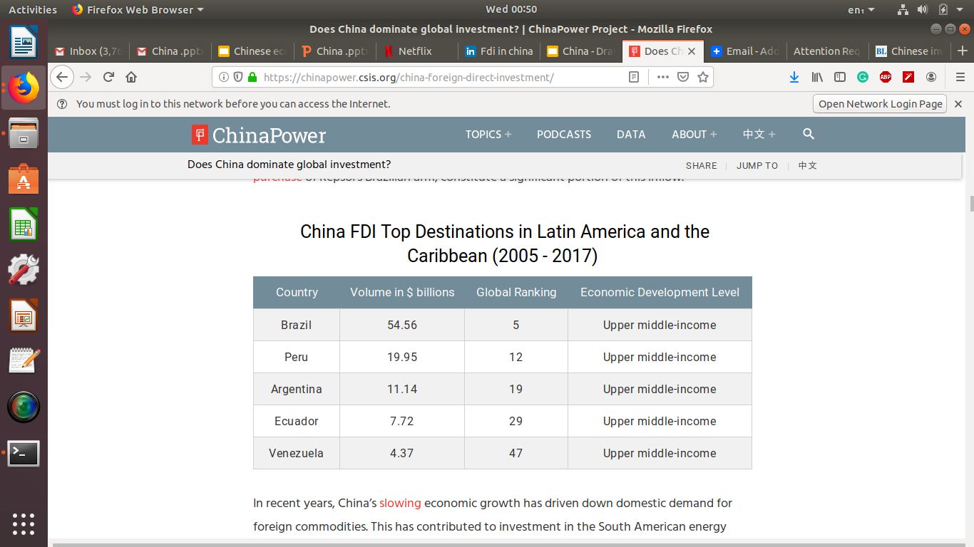
Investment in Latin America

Slide 33
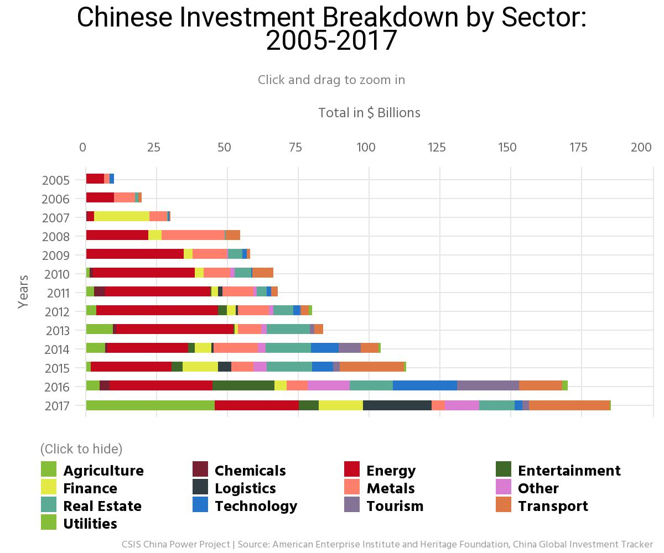
Investment in Latin America
Investment less than $5 billion prior to 2010, when it jumped to $25.3 billion.
China was the biggest investor in LAC with deals totaling $18 billion (42 percent of the total).
Abundant natural resources make LAC a highly desirable investment destination for China
China Development Bank and the Export-Import Bank of China – have issued 85 loans amounting to $150.4 billion from 2005 to 2017 for energy, transportation, and infrastructure projects.

Slide 34
Investment in Latin America
Strengthening of bilateral relationships with countries.
Less interference from USA (busy in building WALL).
China surpassed US as a top trading partner.
Employment for chinese workers.
China viewed Latin America as a source of raw material.

Slide 35
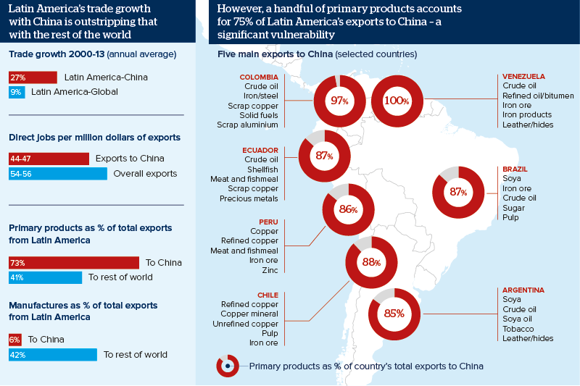

Slide 36
Investment in Africa
In 2016, China was the largest investor in Africa(39%).
Chinese investment in Africa is a more market-driven phenomenon.
At the Chinese companies, 89% of employees are African.
Strategic place for China’s economic and political interests(Belt and Road Initiative).

Slide 37
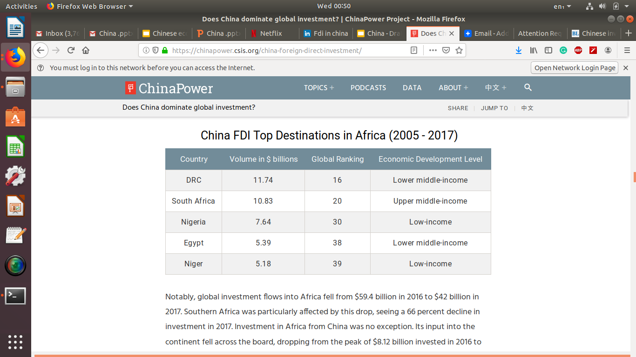
China Bilateral Investment Outflows
Notes:
China Bilateral Investment Outflows

Slide 38
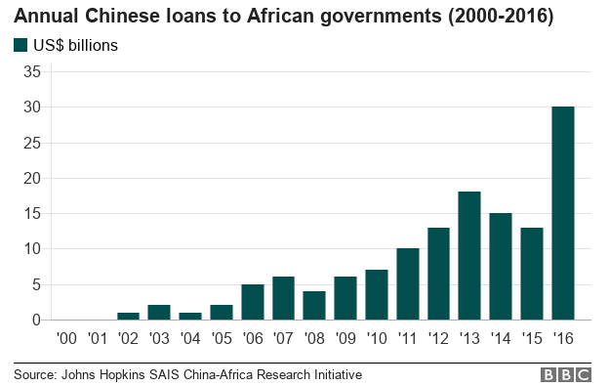

Slide 39
Chinese investments in Indian start-ups
Chinese VC funds pumped in over $5 billion in 2018, surpassing investments coming into the country from the US and Japan.
The top Chinese investors were Alibaba, Shunwei Capital, Fosun Tencent and Xiaomi.
Food-tech, logistics, retail and fintech among sectors that attracted maximum investments

Slide 40
“Made In China 2025”: a plan announced in 2015 to upgrade and modernize China’s manufacturing in 10 key sectors through extensive government assistance in order to make China a major global player in these sectors.
China wants its currency ,the yuan to replace the U.S. dollar as the world’s global currency .
Future of China

Slide 41
Some experts believe that as 20th century was to US, this century might be the one for China.
The Belt and Road Initiative(BRI) 2049 was launched
in 2013 to boost economic integration and connectivity (such as
infrastructure, trade, and investment) with its neighbors and
various trading partners in Asia, Africa, Europe, and beyond.

Slide 42
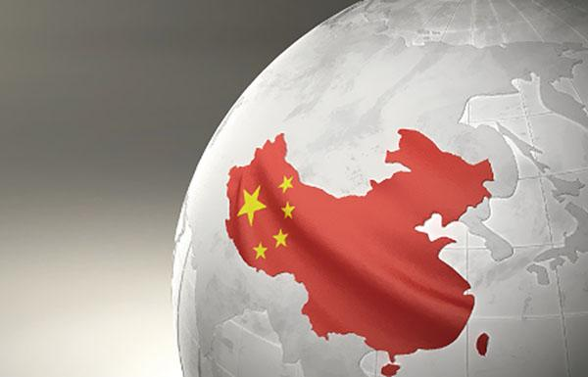
China would like to be
competitive with
developed manufacturing
economies in 2035.
The ultimate target is to
change China from a
mass-producer
to a quality-master.

Slide 43
References
Sites to visit:
https://chinapower.csis.org/china-foreign-direct-investment/
https://www.thehindubusinessline.com/companies/chinese-investments-in-indian-start-ups-cross-5-b-in-2018/article26612436.ece
Sites to avoid:
https://en.wikipedia.org/wiki/Economy_of_China
https://www.quora.com/How-dangerous-would-Trumps-China-policy-be-for-the-world-economy

Slide 44

This presentation
is dedicated to
Kung Fu Masters

Slide 45
Thank you!

